Slide 1

ASSIGNMENT 1 – ADDS/DNS/DHCP
DAPHNE CAMODOC

Slide 2
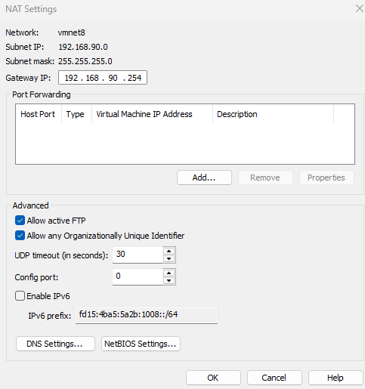
VMWare NAT network configuration
192.168.X.0/24 Network
192.168.X.254 Gateway
no DHCP

Slide 3
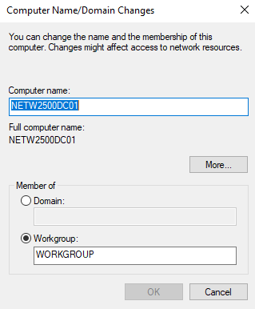
Name server NETW2500DC01

Slide 4
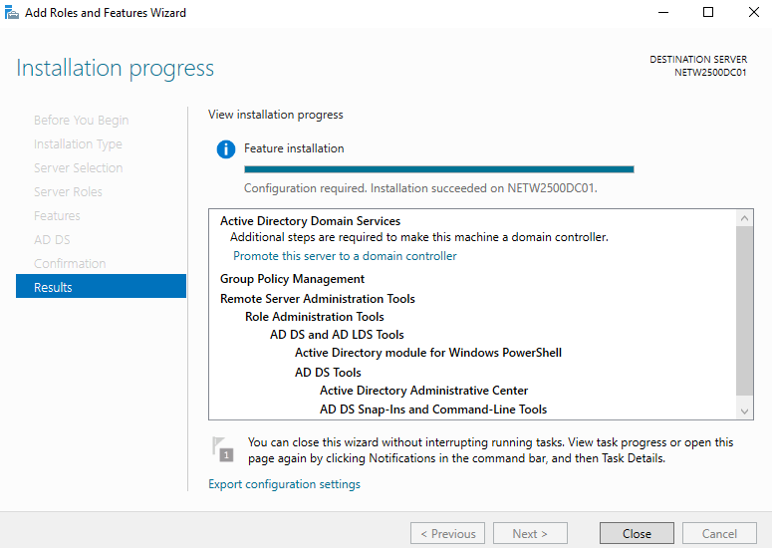
Add ADDS role

Slide 5
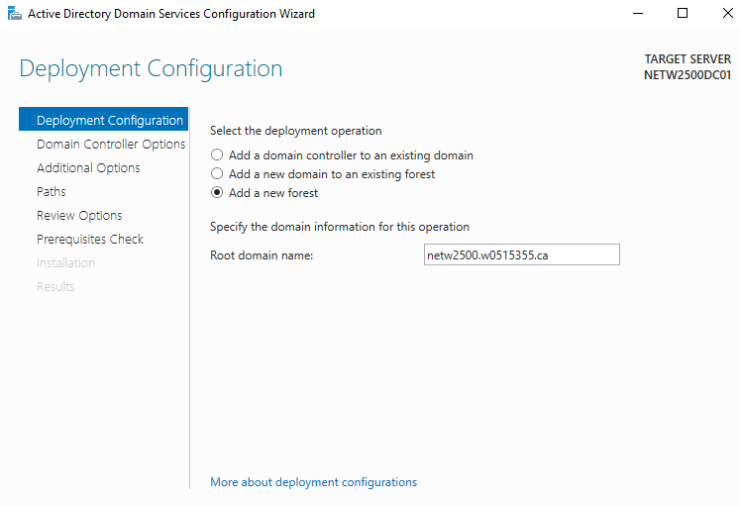
Promote domain controller

Slide 6
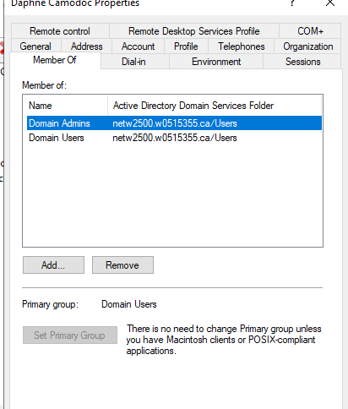
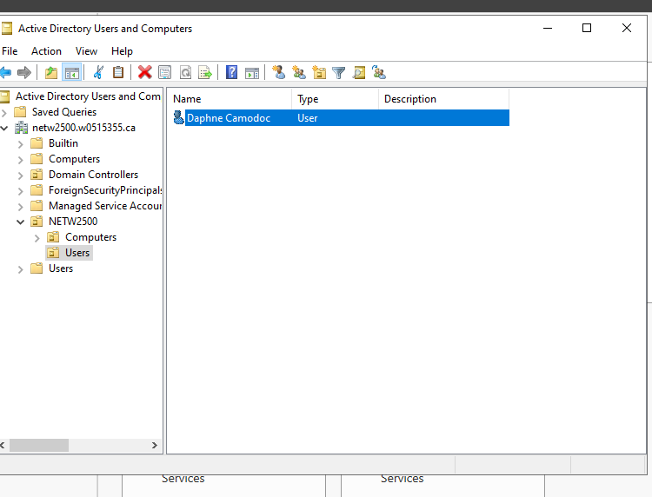
Create OU structure: netw2500 -> users/computers Create user: w# Add user to domain admins group

Slide 7
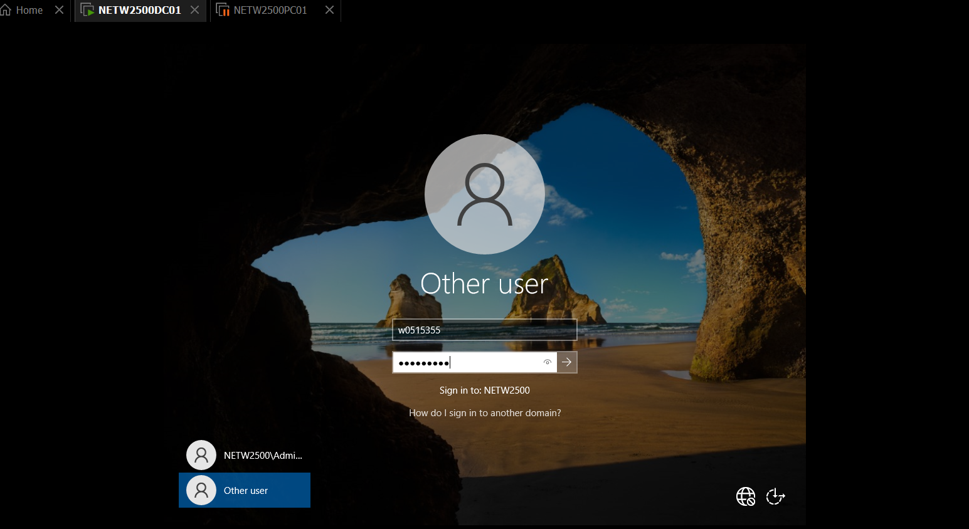
Login as this user

Slide 8
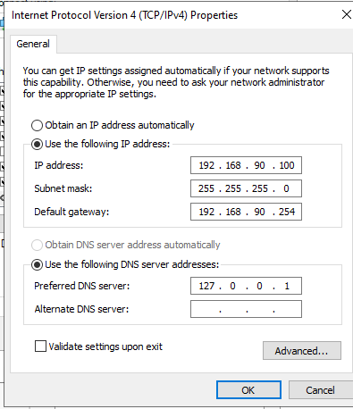
Configure a static IP using the following settings: 192.168.X.100 255.255.255.0 192.168.X.254 127.0.0.1

Slide 9
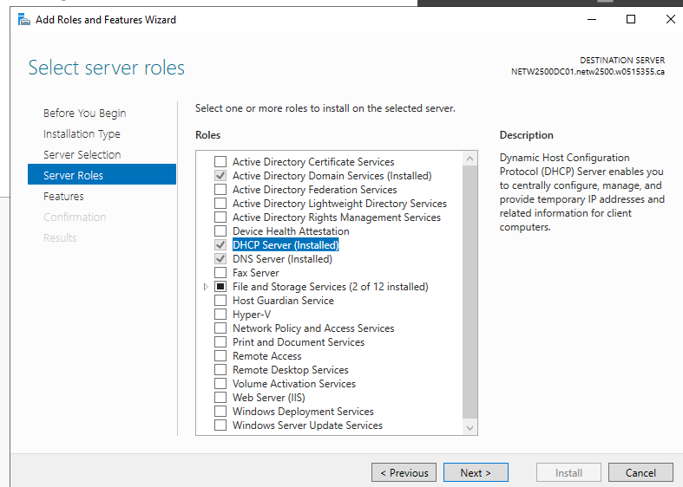
Add DHCP role

Slide 10
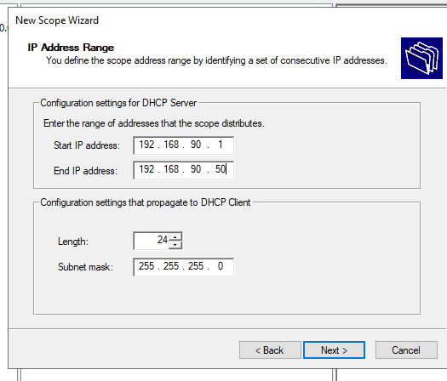
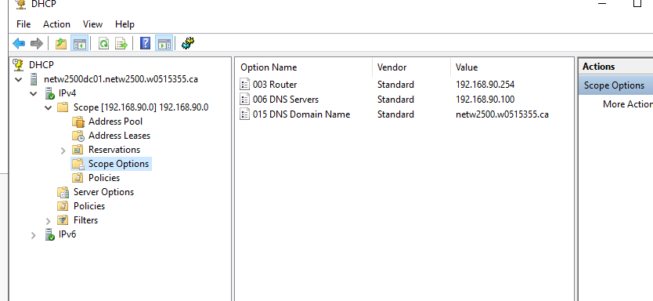
Create new scope network 192.168.X.0 range 192.168.X.1-192.168.X.50 gateway 192.168.X.254 subnet mask 255.255.255.0 DNS 192.168.X.100

Slide 11
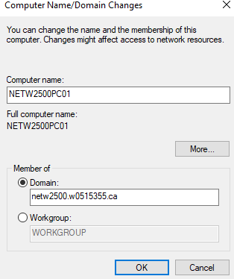
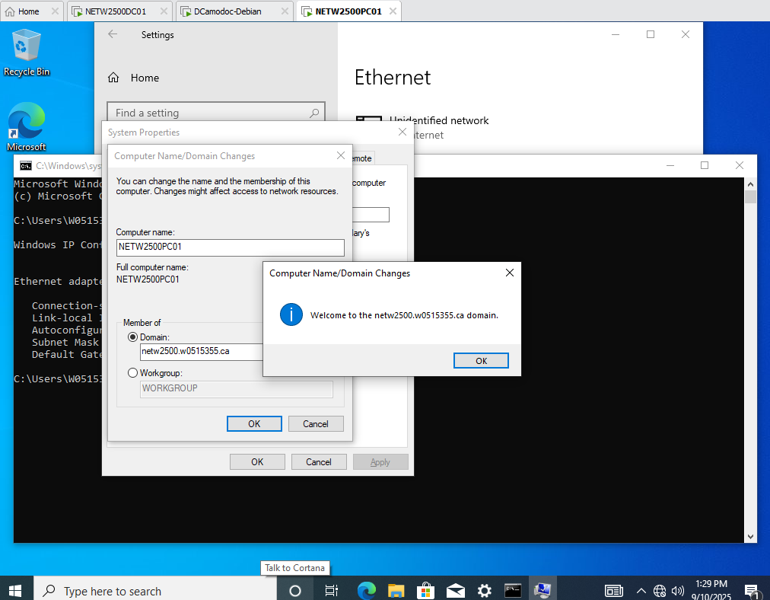
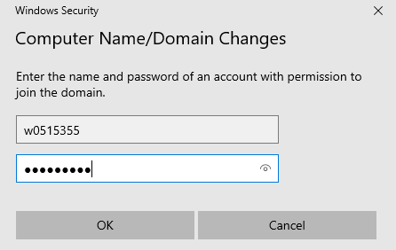
Turn on pc, name it, and join to domain Name PC: NETW2500PC01

Slide 12
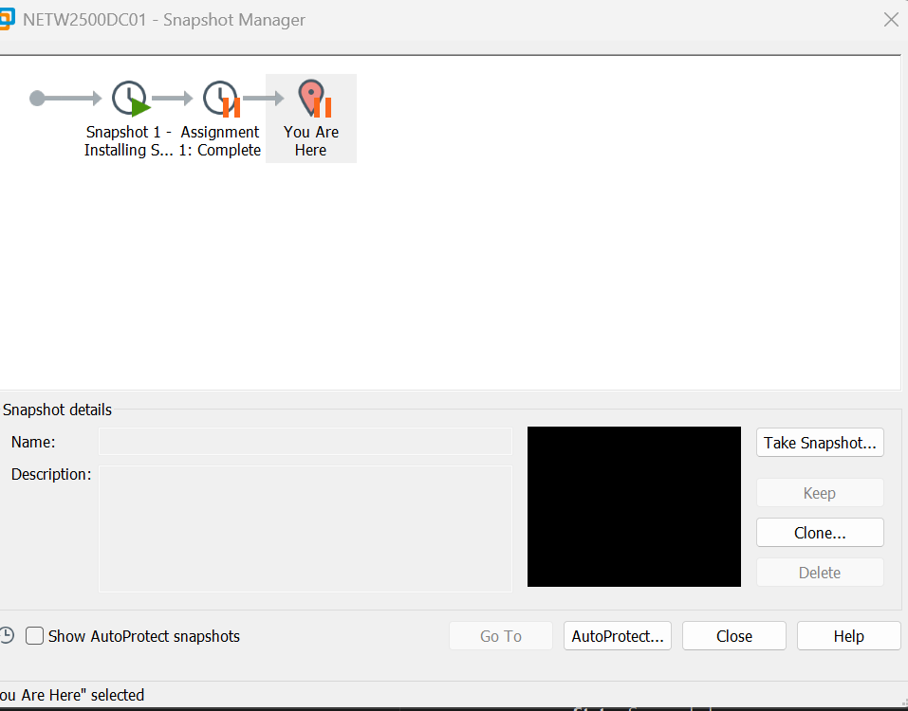
Take a snapshot

